Slide 1
Learning Safe Cooperative Policies in Autonomous Multi-UAV Navigation
Arshdeep Singh
Indian Institute of Technology Ropar
2019csm1001@iitrpr.ac.in
Shashi Shekhar Jha
Indian Institute of Technology Ropar
shashi@iitrpr.ac.in

Slide 2
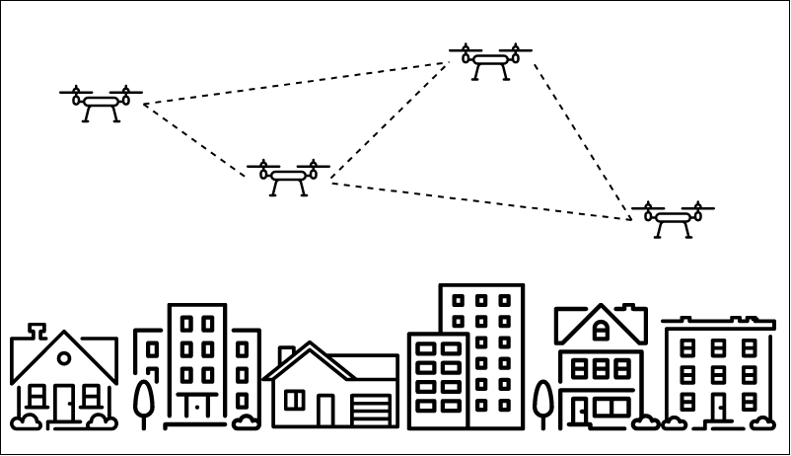
Multi-UAV Applications
Application Domains
Surveying, Remote Sensing, Search & Rescue, E-Commerce Delivery

Slide 3
Problem Formulation
Multi-UAVs learning to autonomously reach their target destination through safe navigation
Each UAV should avoid collision with other UAVs
Formulated as a Multi Agent Reinforcement Learning(MARL) problem
MARL is when we are considering various intelligent agents interacting with an environment
Multi Agent scenario
Cooperative
Competitive
Mixture of both

Slide 4
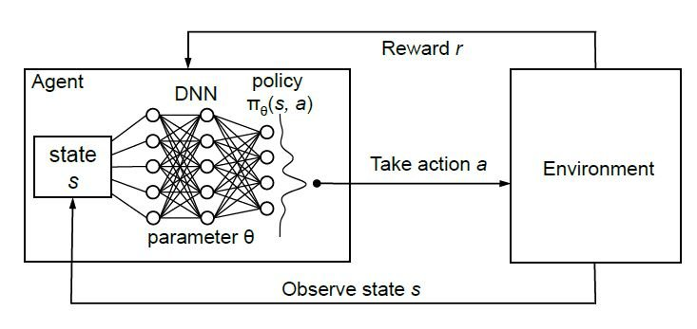
Reinforcement Learning at a glance
RL feedback loop[1]

Slide 5
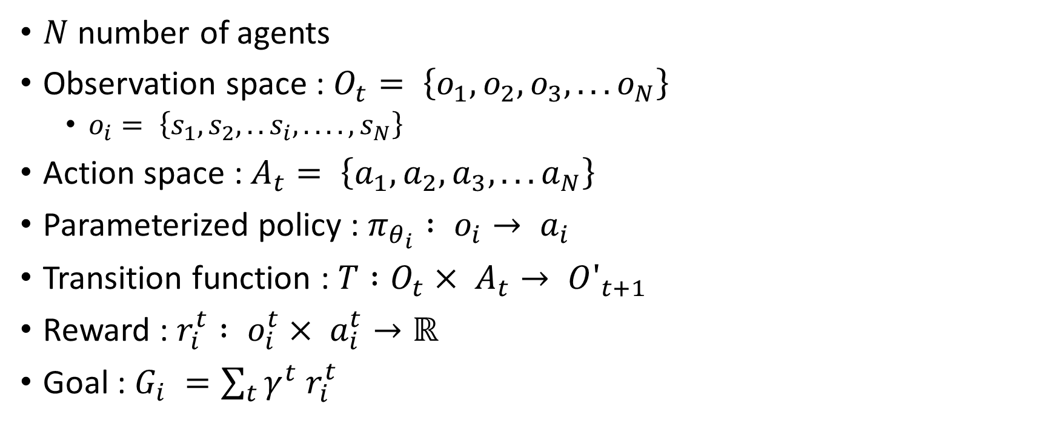
System Dynamics
$N$ number of agents
Observation space : $O_{t}= \left\{o_{1}, o_{2}, o_{3}, ... o_{N}\right\}$
$o_{i}= \left\{s_{1},s_{2},..s_{i},....,s_{N}\right\}$
Action space : $A_{t}= \left\{a_{1}, a_{2}, a_{3}, ... a_{N}\right\}$
Parameterized policy : $π_{θ_{i}} : o_{i}→ a_{i}$
Transition function : $T :O_{t}× A_{t}→ O′_{t+1}$
Reward : $r_{i}^{t} : o_{i}^{t}× a_{i}^{t}→ℝ$
Goal : $G_{i} =\sum_{t}{γ^{t} r_{i}^{t}}$

Slide 6
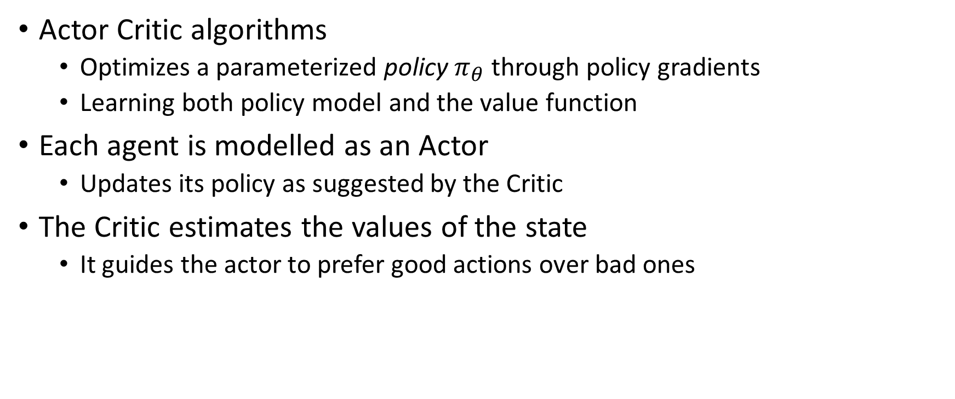
System Dynamics
Actor Critic algorithms
Optimizes a parameterized policy $π_{θ}$ through policy gradients
Learning both policy model and the value function
Each agent is modelled as an Actor
Updates its policy as suggested by the Critic
The Critic estimates the values of the state
It guides the actor to prefer good actions over bad ones

Slide 7
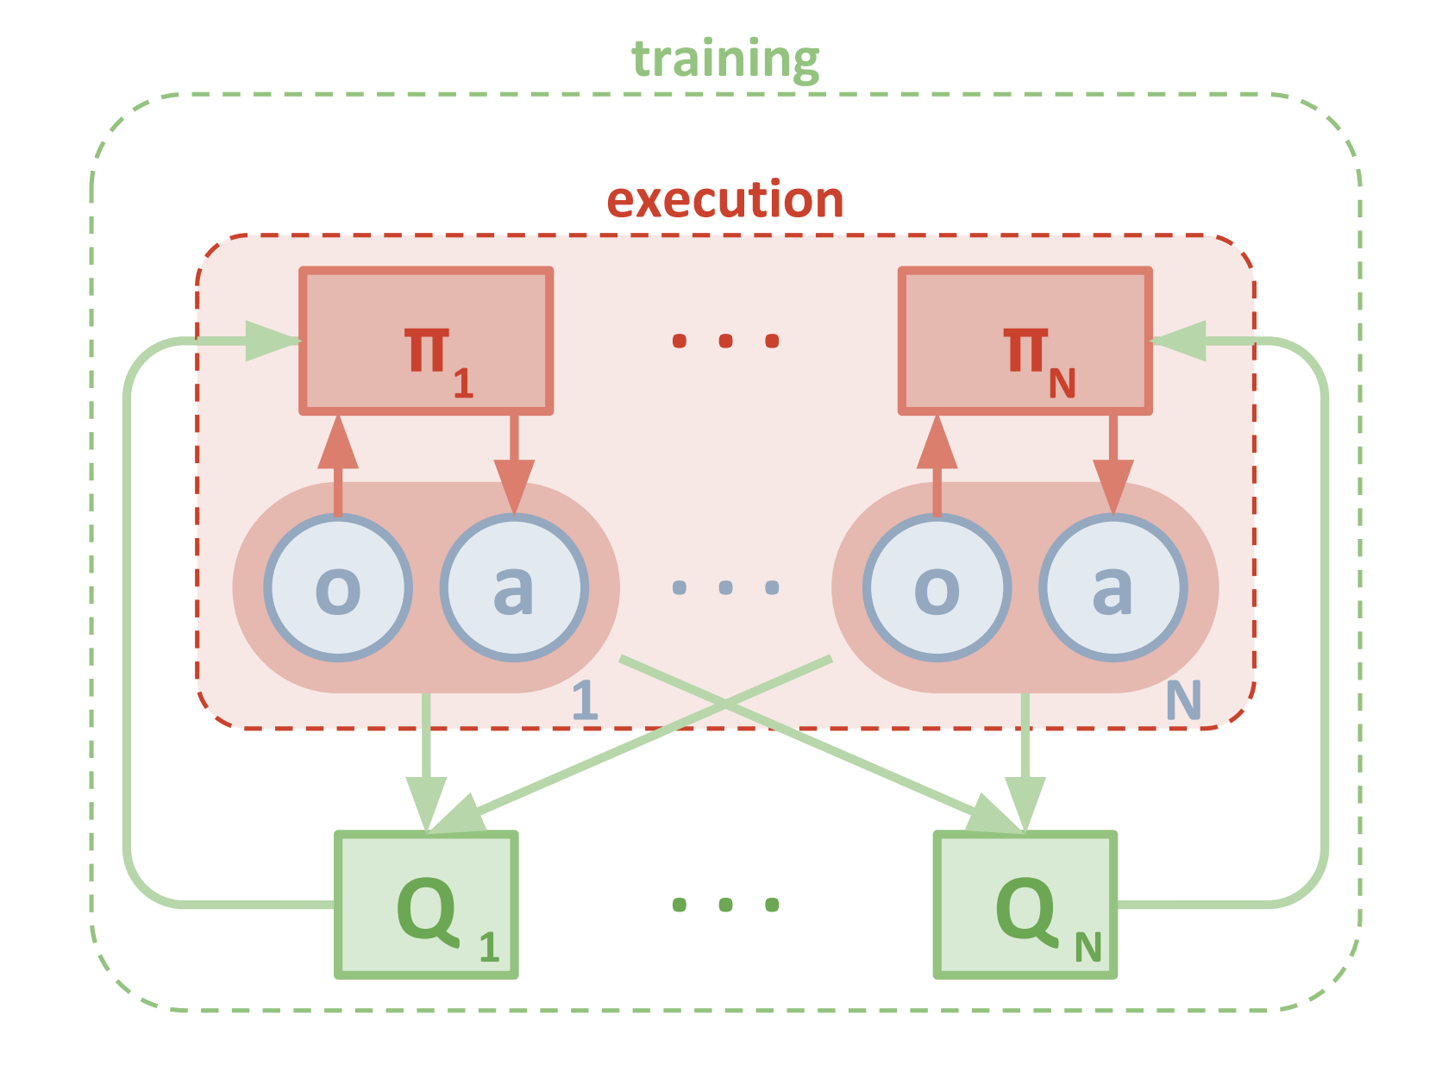
MADDPG (Lowe et al)[2]
Multi Agent Deep Deterministic Policy Gradient
Centralized Critic network, Decentralized execution (multiple independent Actors), Deterministic Policy function
Architecture
An actor network for using observations for deterministic actions
An identical target actor network for training stability
A critic network that uses joint states action pairs to estimate Q-values
MADDPG[2]

Slide 8
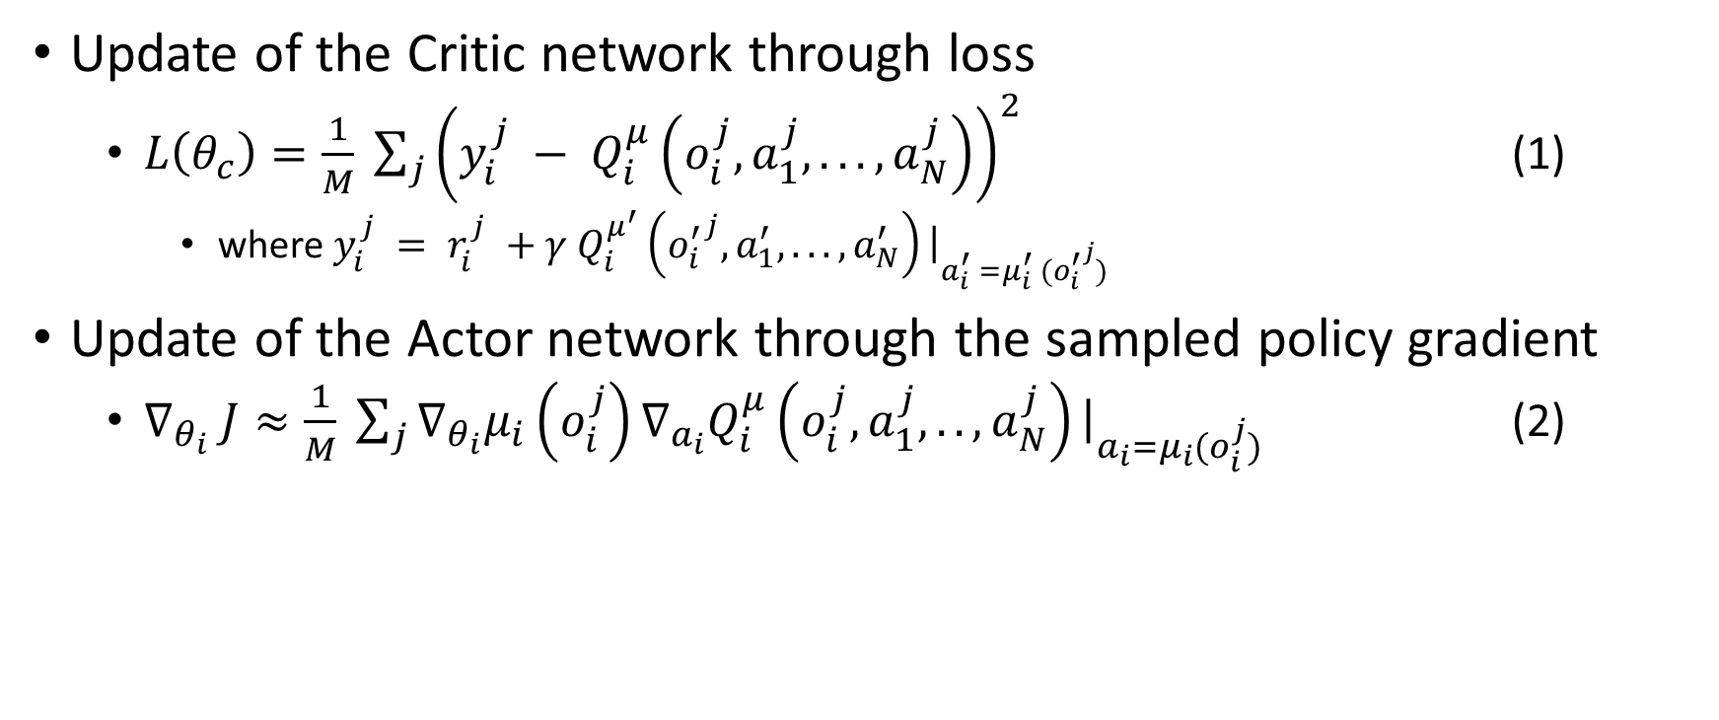
Continued
Update of the Critic network through loss
$L\left(θ_{c}\right)=\frac{1}{M} \sum_{j}{{\left(y_{i}^{j} − Q_{i}^{μ}\left(o_{i}^{j}, a_{1}^{j},...,a_{N}^{j}\right)\right)}^{2}}$ (1)
where $y_{i}^{j} = r_{i}^{j} +γ Q_{i}^{μ^{′}}\left({o_{i}^{′}}^{j}, a_{1}^{′},...,a_{N}^{′}\right){\left.​\right|}_{a_{i}^{′} =μ_{i}^{′} ({o_{i}^{′}}^{j})}$
Update of the Actor network through the sampled policy gradient
$∇_{θ_{i}} J≈\frac{1}{M} \sum_{j}{∇_{θ_{i}}μ_{i}\left(o_{i}^{j}\right)∇_{a_{i}}Q_{i}^{μ}\left(o_{i}^{j}, a_{1}^{j},..,a_{N}^{j}\right){\left.​\right|}_{a_{i}=μ_{i}(o_{i}^{j})}}$ (2)

Slide 9
Issues
No obstacle avoidance : static, dynamic
No safety guarantees
Large state space configuration
Techniques
Safety Controllers[3]
Control Barrier functions[4]

Slide 10
Safe Reinforcement Learning[4]
Learning optimal policies while satisfying Safety Constraints
Safe RL will help in transitioning the control to physical systems
A major challenge in using reinforcement learning is safety - control policies learned using reinforcement learning typically do not provide any safety guarantees

Slide 11
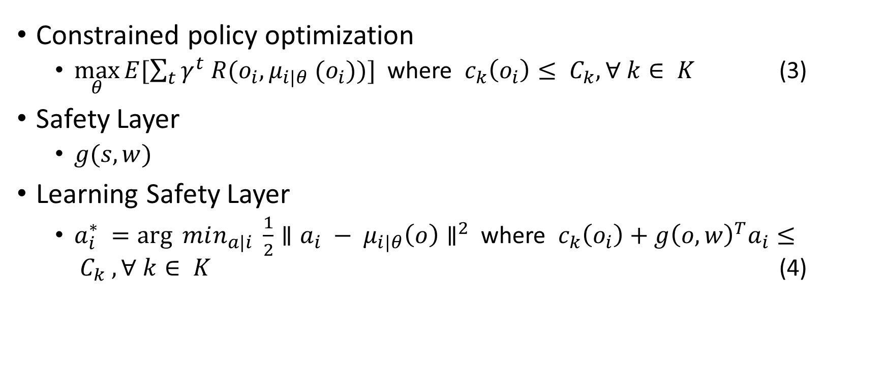
Safety Layer(Dalal et al)[3]
Constrained policy optimization
$\max_{θ}{E[\sum_{t}{γ^{t} R(o_{i}, μ_{i|θ} (o_{i}))}]}$ where $c_{k}\left(o_{i}\right)≤ C_{k}, ∀ k∈ K$ (3)
Safety Layer
$g(s, w)$
Learning Safety Layer
$a_{i}^{∗} =\arg{ min_{a|i}} \frac{1}{2}∥a_{i} − μ_{i|θ}\left(o\right)∥^{2}$ where $c_{k}\left(o_{i}\right)+g{\left(o, w\right)}^{T}a_{i}≤ C_{k} , ∀ k∈ K$ (4)

Slide 12
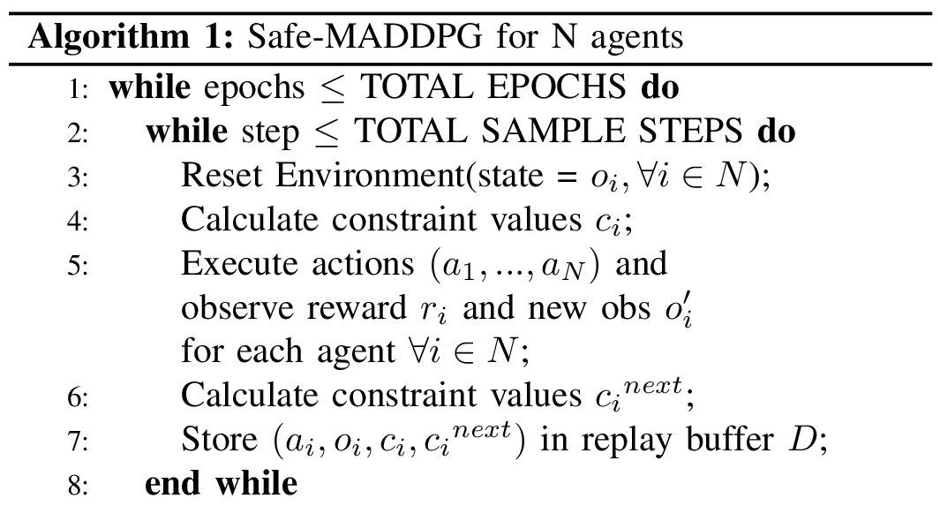
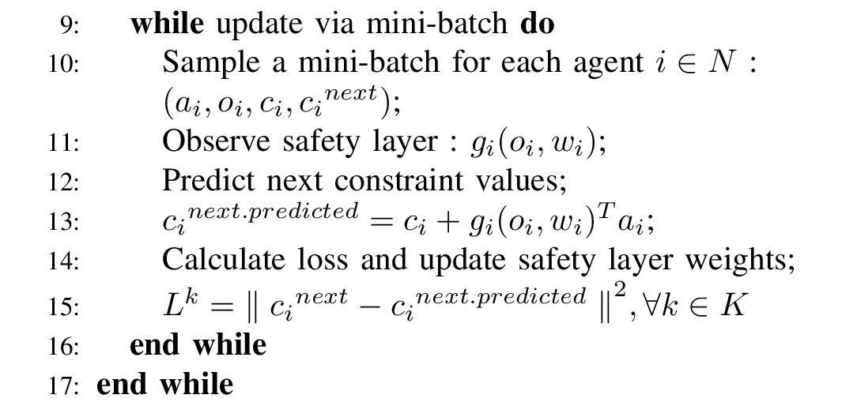
Safe-MADDPG
Step 1
Safety Network update

Slide 13
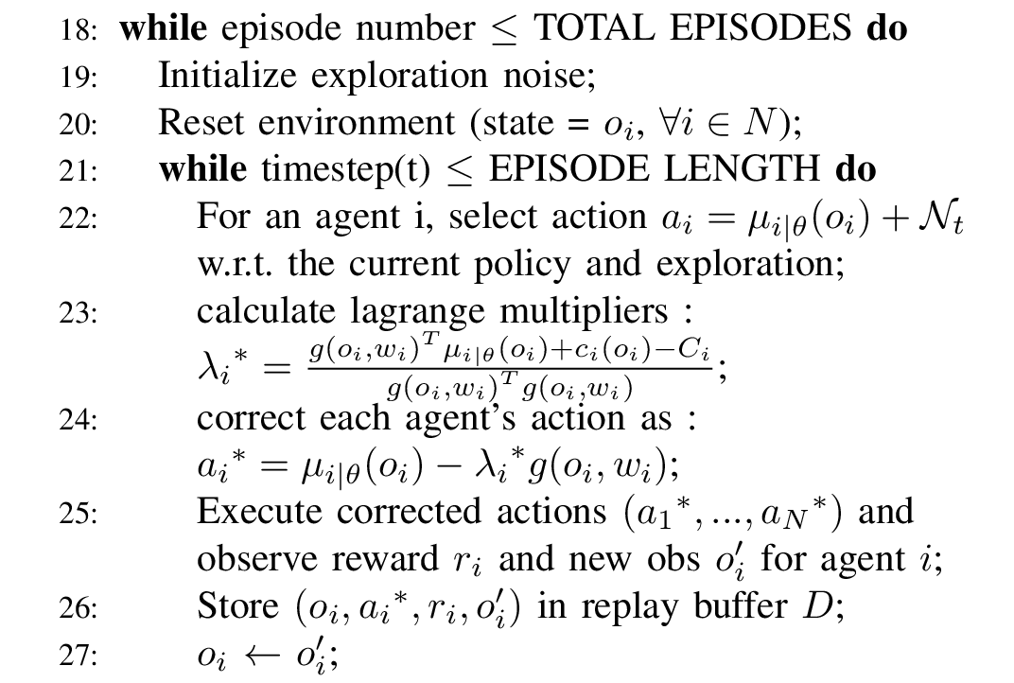
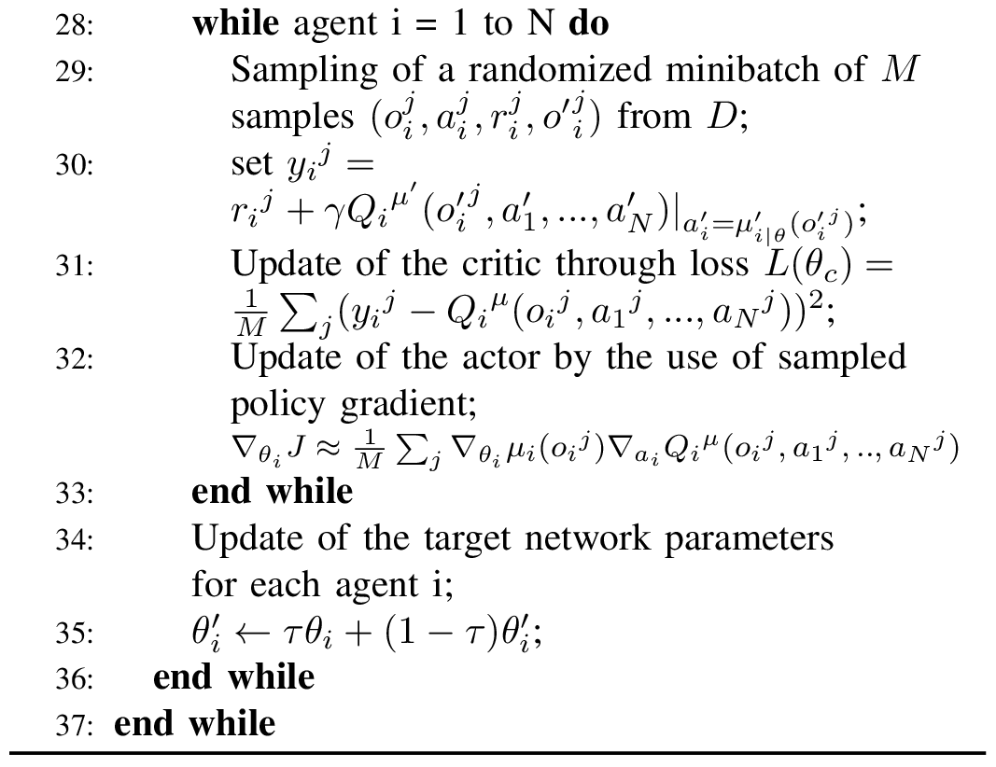
Safe-MADDPG
Step 2
Next

Slide 14
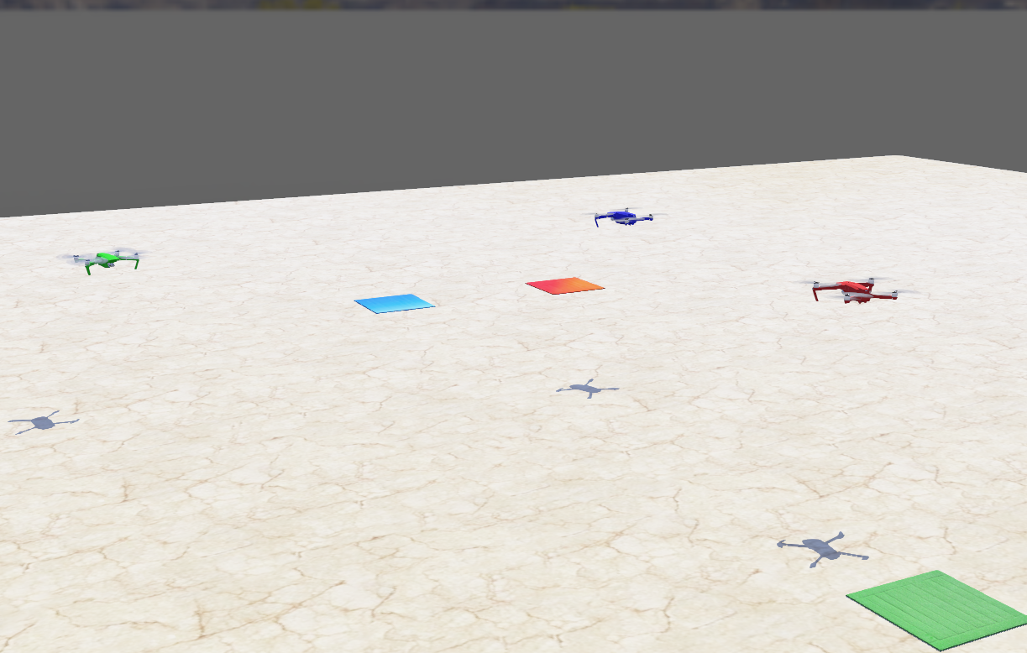
Experimentation
Multiple UAVs and their Target locations
UAV : DJI Mavic
Webots Simulation by Cyberbotics[5]
Real world physics engine
Deepbots[6]: Deepbots is a simple framework which is used as middleware between the Webots Simulator and Reinforcement Learning algorithm
Emitter-Receiver scheme
Combined robot-supervisor controller scheme

Slide 15
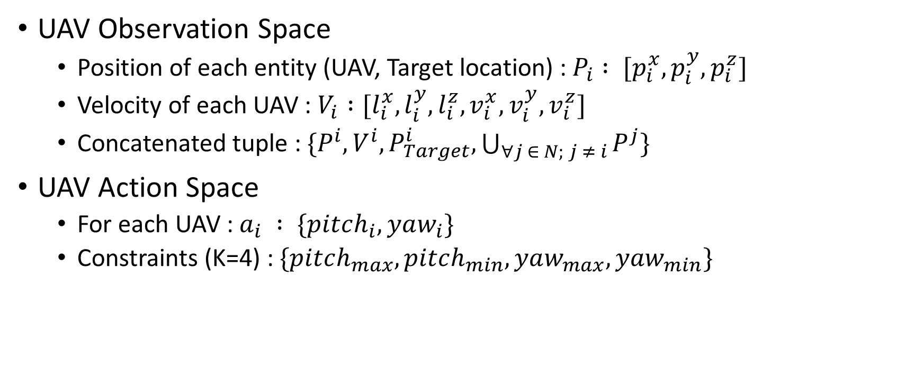
System Settings
UAV Observation Space
Position of each entity (UAV, Target location) : $P_{i} : [p_{i}^{x}, p_{i}^{y}, p_{i}^{z}]$
Velocity of each UAV : $V_{i} :[l_{i}^{x}, l_{i}^{y}, l_{i}^{z}, v_{i}^{x}, v_{i}^{y}, v_{i}^{z}]$
Concatenated tuple : $\{P^{i}, V^{i}, P_{Target}^{i}, \bigcup_{∀j ∈ N; j ≠ i}{P^{j}}\}$
UAV Action Space
For each UAV : $a_{i} : \{pitch_{i}, yaw_{i}\}$
Constraints (K=4) : $\{pitch_{max},pitch_{min},yaw_{max},yaw_{min}\}$

Slide 16
Reward Structure
Reward Value | Conditions
-4 | if the angle between UAV and its target is > 1.5 Radians
-2 | if angle < 1.5 Radians and curr_dist > prev_dist
-2 | if angle < 0.1 Radians and curr_dist > prev_dist
+5 | if angle < 1.5 Radians and curr_dist < prev_dist
+10 | if angle < 0.1 Radians and curr_dist < prev_dist
-10 | if there is a collision

Slide 17
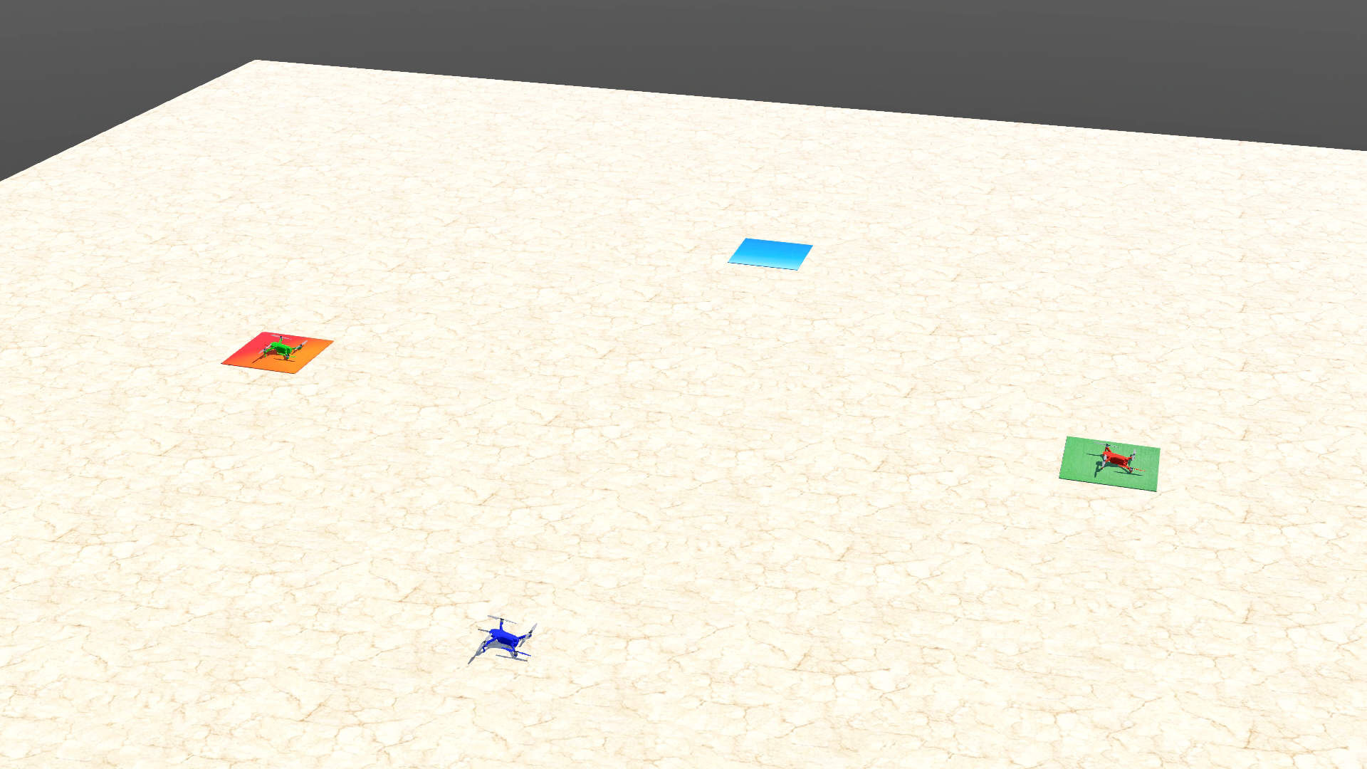
Results (3 UAV scenario)

Slide 18
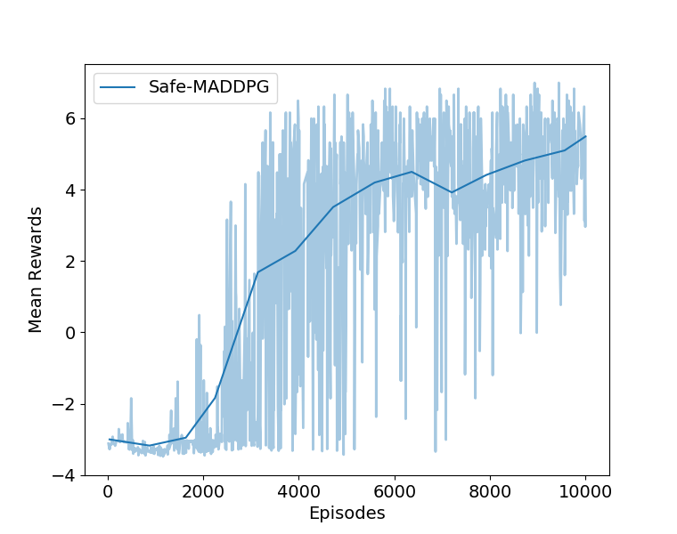
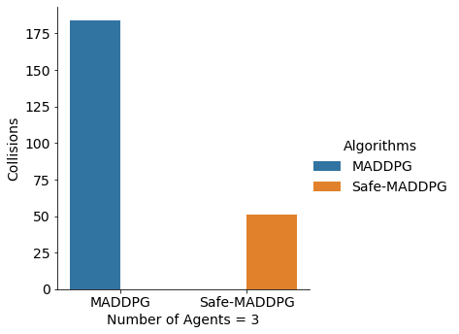
Evaluation
Mean Rewards
Testing final policies

Slide 19
Multi-UAV behavior using MADDPG

Slide 20
Multi-UAV behavior using Safe-MADDPG

Slide 21
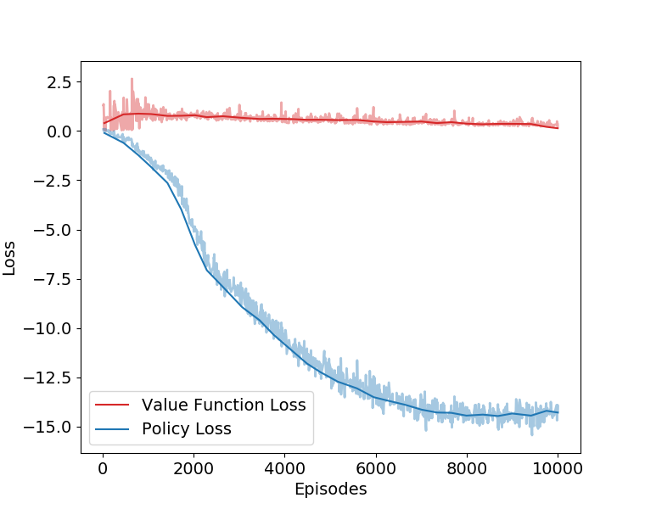
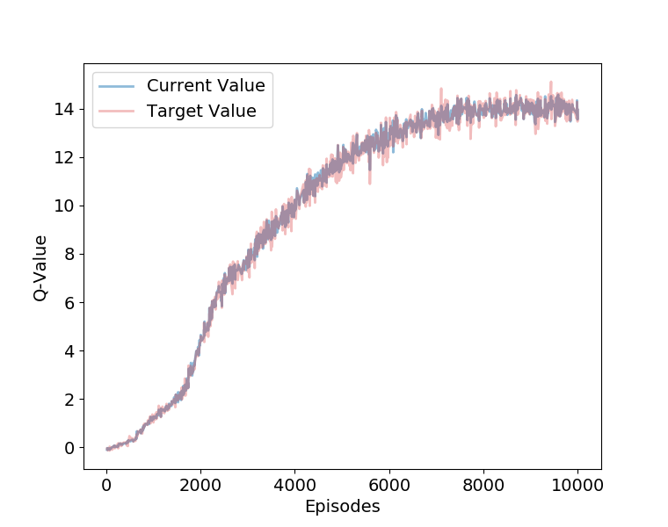
Evaluation
Value & Policy Loss
Current – Target Q-Value

Slide 22
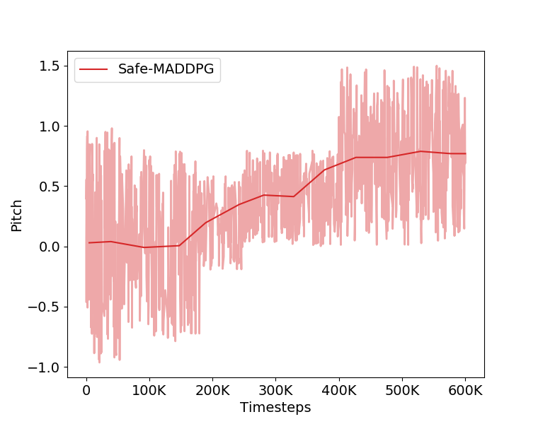
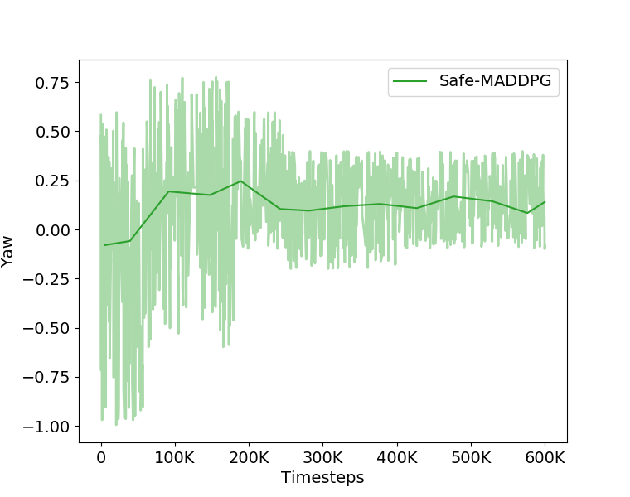
Evaluation
Pitch variation
Yaw variation

Slide 23
Conclusions
Safe-MADDPG for learning safe cooperative policies for Multi-UAV navigation via safety layer
The proposed Safe-MADDPG is better able to handle collisions than MADDPG
Future work to evaluate with more complex environments with static and dynamic obstacles, etc.

Slide 24
References
Deep Reinforcement Learning (researchgate.net)
R.Lowe, Y.Wu, A.Tamar, J.Harb, P.Abbeel, and I. Mordatch, “Multi-agent actor-critic for mixed cooperative-competitive environments,” CoRR, vol. abs/1706.02275, 2017.
G.Dalal, K.Dvijotham, M. Vecerık, T. Hester, C.Paduraru, and Y.Tassa, “Safe exploration in continuous action spaces,” CoRR, vol. abs/1801.08757, 2018.
R.Cheng, G.Orosz, R.M.Murray, and J.W.Burdick, “End-to-end safe reinforcement learning through barrier functions for safety-critical continuous control tasks,” in Proceedings of the AAAI Conference on Artificial Intelligence, vol. 33, 2019.
Webots, “http://www.cyberbotics.com,” open-source Mobile Robot Simulation Software. [Online]. Available: http://www.cyberbotics.com.
M.Kirtas, K.Tsampazis, N.Passalis, and A.Tefas, “Deepbots: A Webots-based deep reinforcement learning framework for robotics,” in Artificial Intelligence Applications and Innovations. Cham: Springer International Publishing, 2020.

Slide 25
Thank You!

